Slide 1
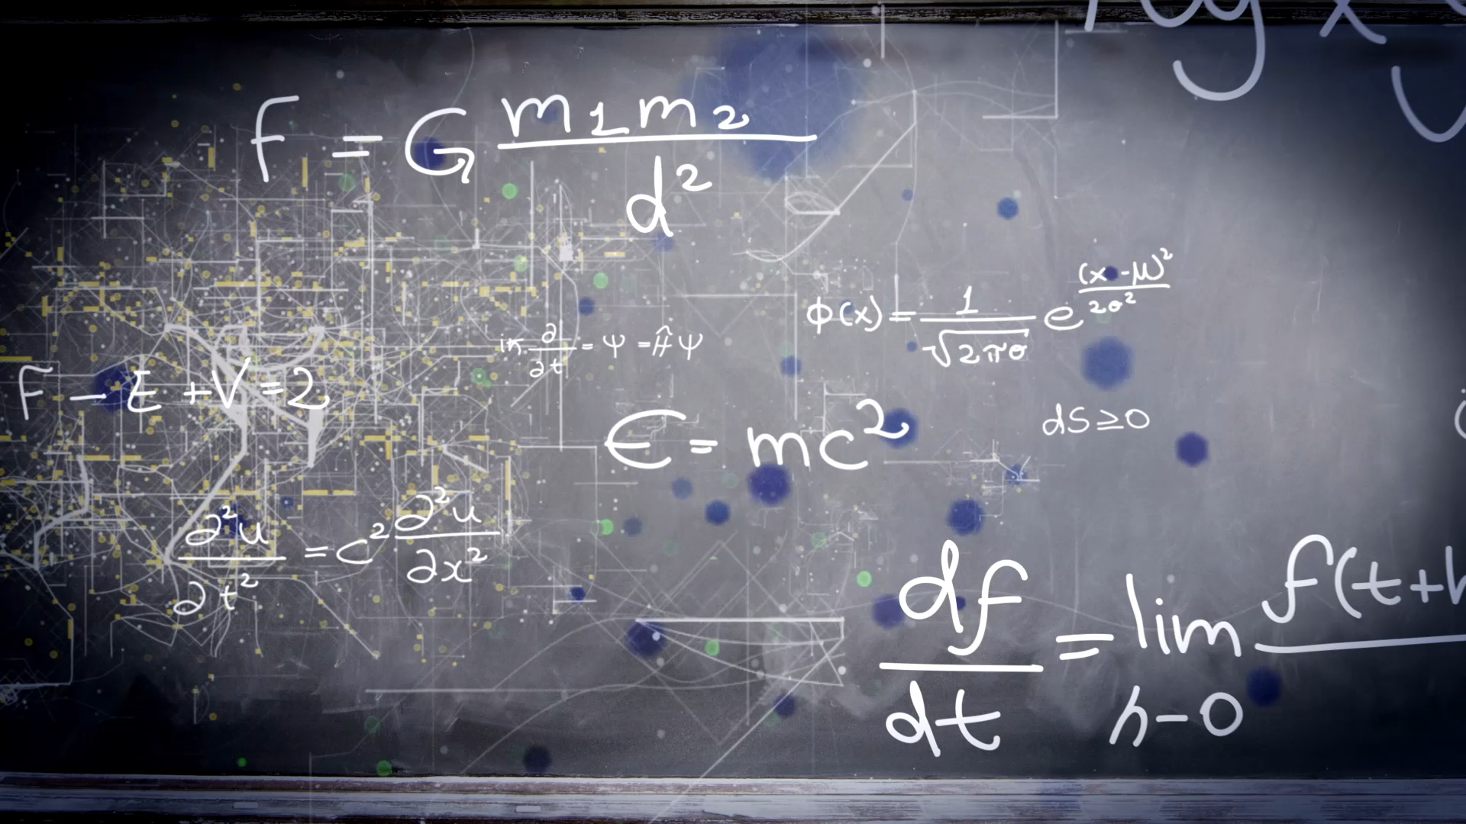
APPLIANCE ENERGY PREDICTION
IE 7300
Statistical Learning for Engineering
GROUP 11
Navneet Gujjar
Nithin Chandra
Tarush Singh
Thomas George Thomas

Slide 2
Introduction
The Appliances Energy Prediction dataset includes variables related to home appliances, weather patterns, and other elements
Each instance in the dataset represents a 10-minute period, totaling more than 19,000 instances in the dataset
The information was collected over a 4.5-month period
The primary objective is for Machine Learning research to create and evaluate models for energy prediction tasks that can be helpful to optimize energy utilization

Slide 3
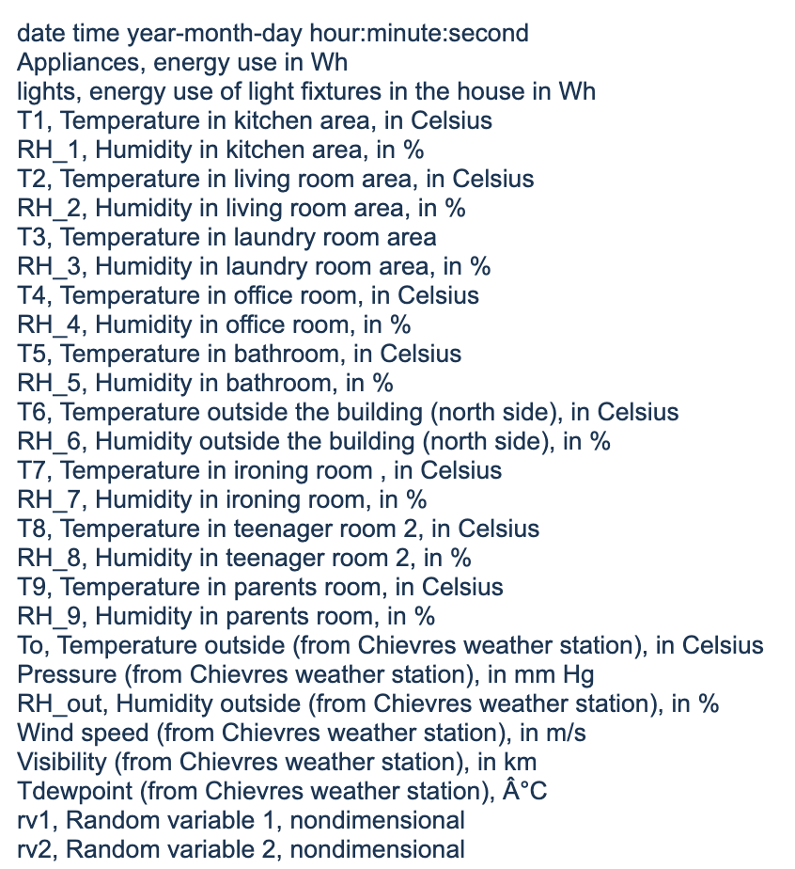
Data Description

Slide 4
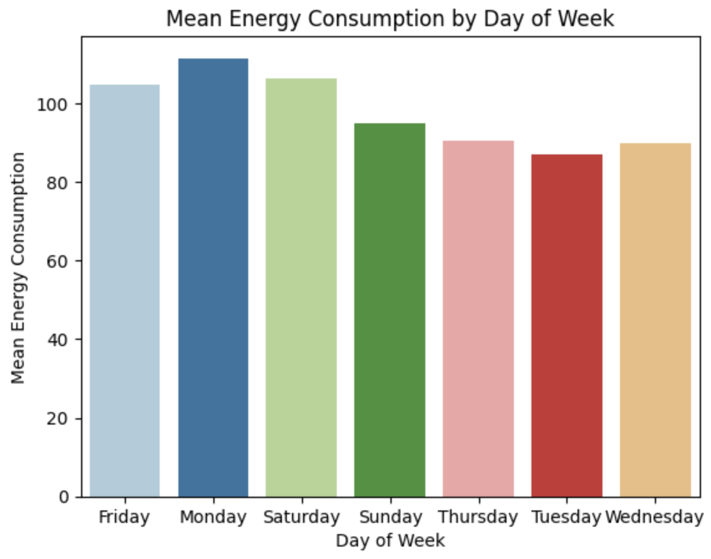
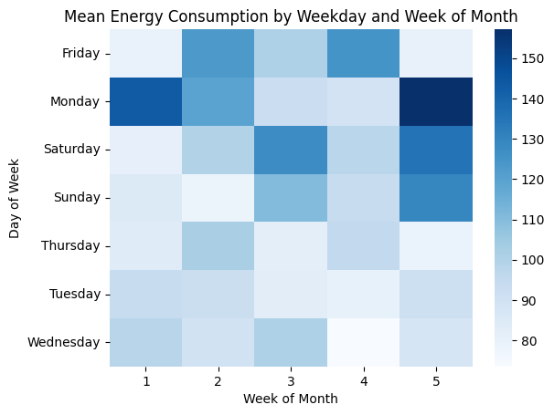
EDA & Preprocessing
Appliance energy consumption analysis revealed higher mean energy usage on Fridays, Saturdays, and Sundays
Weekends showing increased consumption on average
Midweek power consumption was consistently low, while weekends experienced fluctuations throughout the month
No NULL values were found in the dataset

Slide 5
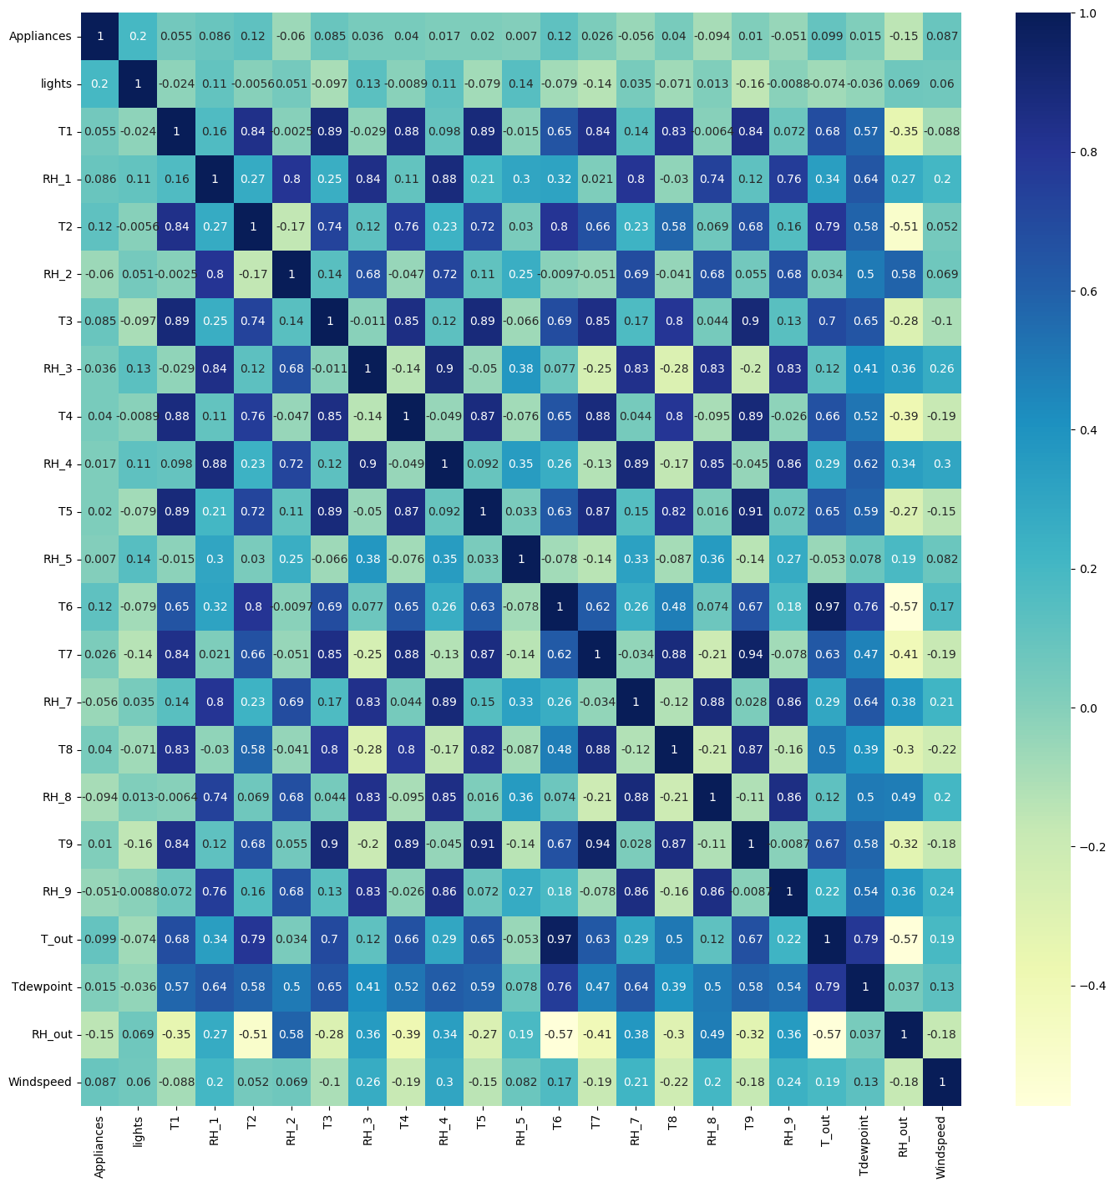
A correlation plot displays correlation coefficients between variables measuring the strength and direction of linear relationships on a -1 to +1 scale
Temperature and humidity variables are highly correlated
To avoid multicollinearity, these correlated variables are removed during feature selection

Slide 6
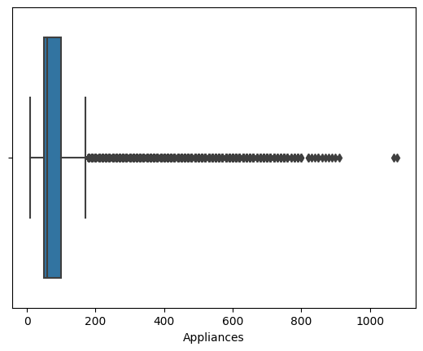
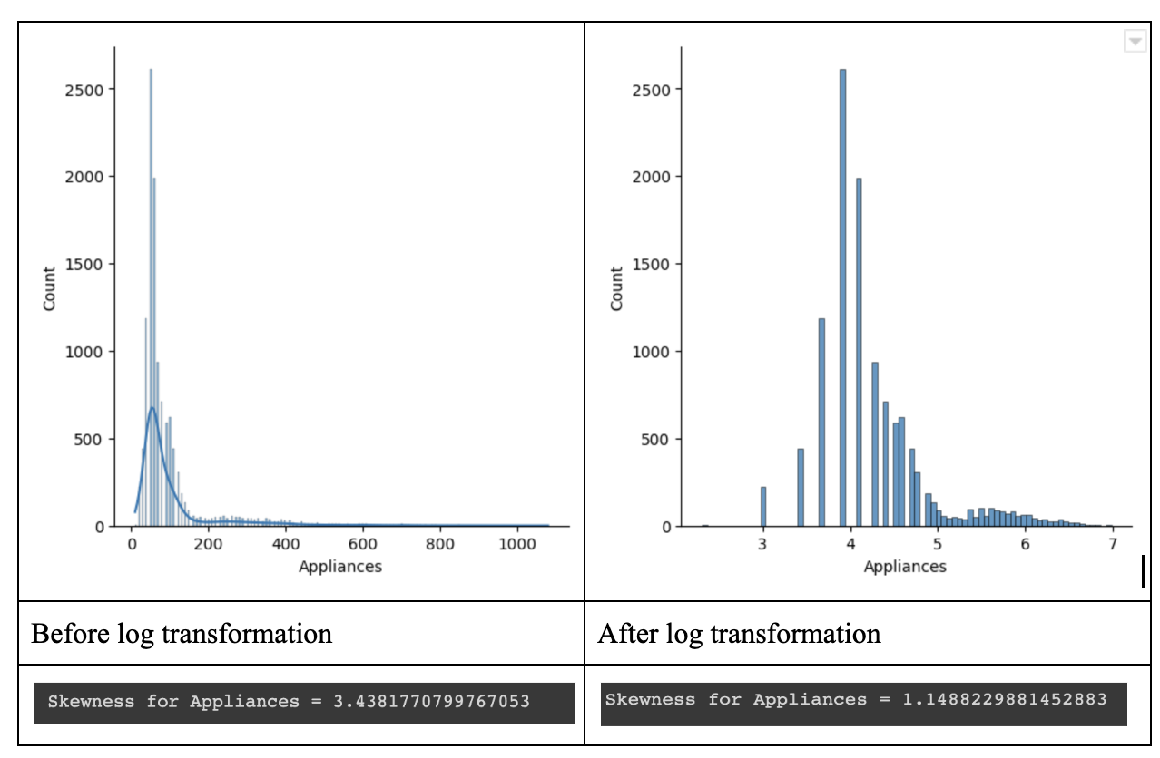
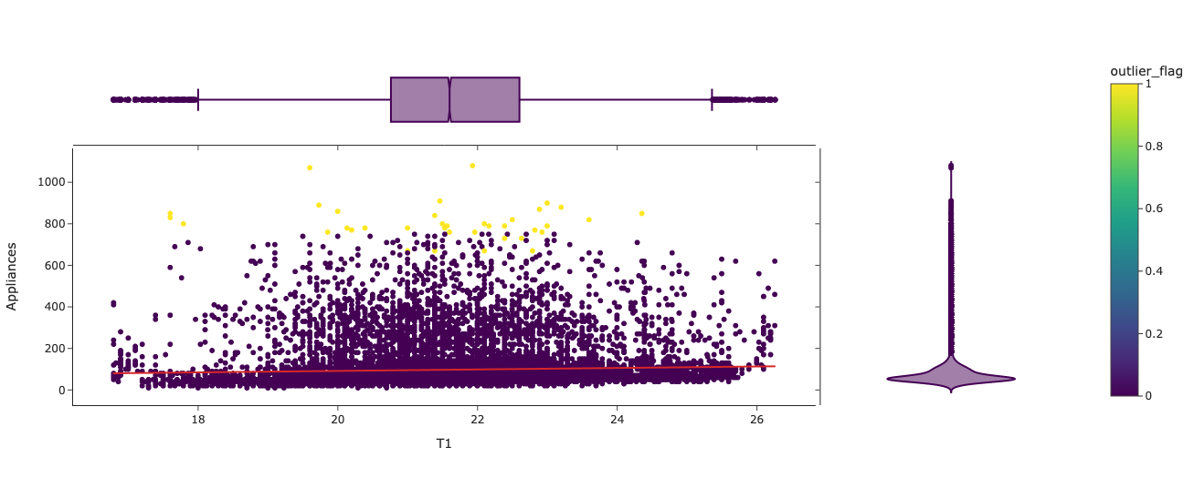
The data is skewed concentration towards the lower end of the Appliances
Based on the position of the median value, we may decide if a distribution is skewed or not
The distribution is right-skewed when the median is closer to the bottom of the box and the whisker is shorter on lower end of the box
The points in yellow were flagged as outliers by the DBSCAN algorithm
The outliers weren’t removed as there was no conclusive evidence that these data points were erroneous.

Slide 7
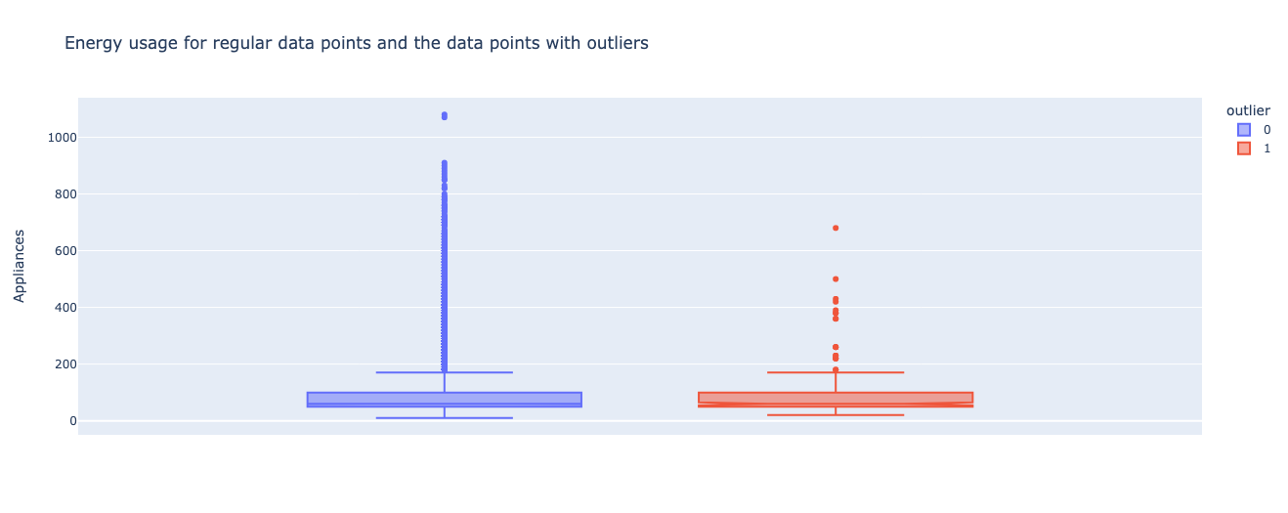
The distribution of the outliers determined from the input variables is displayed in the boxplot
There are no outliers in the distribution for the target variable
The median for both the typical data points and the outliers is 60
The prospective outlier values weren't eliminated because there wasn't any outlier behavior

Slide 8
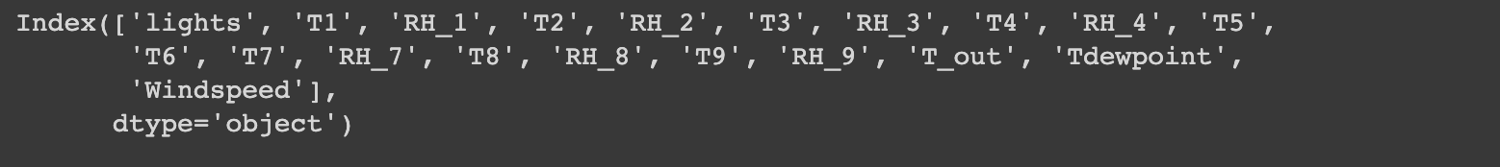
Feature Selection
Recursive Feature Elimination (RFE) with Logistic Regression was used for feature selection
RFE aims to reduce the number of features until the required number is obtained by removing the least significant features from a given set of features.

Slide 9
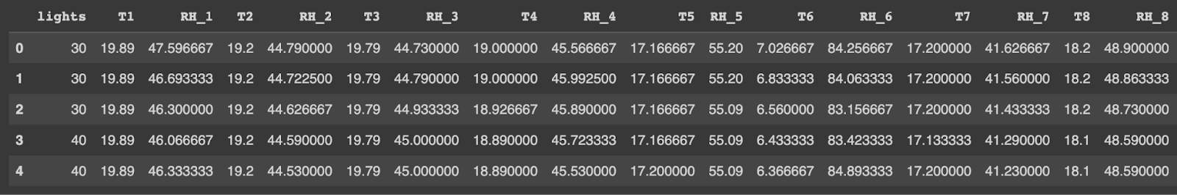
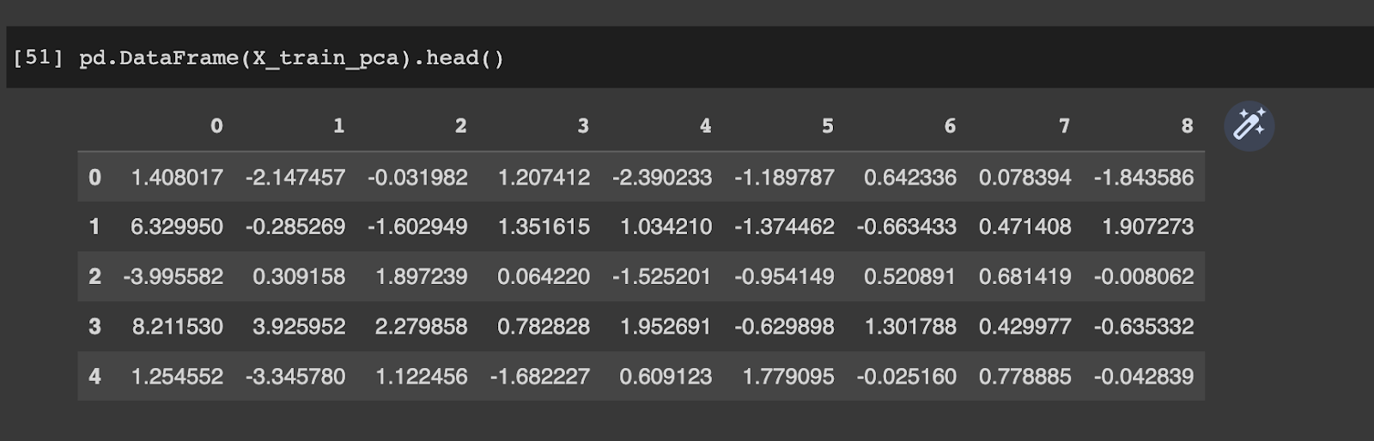
Dimensionality Reduction
Input dataframe before scaling and PCA
Input dataframe after scaling and PCA

Slide 10

Machine Learning Model Implementation
Machine Learning Models
Linear Regression
Lasso Regression
Ridge Regression
Neural Networks

Slide 11
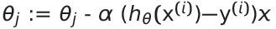

Linear Regression
Gradient Descent
Stochastic Gradient Descent

Slide 12
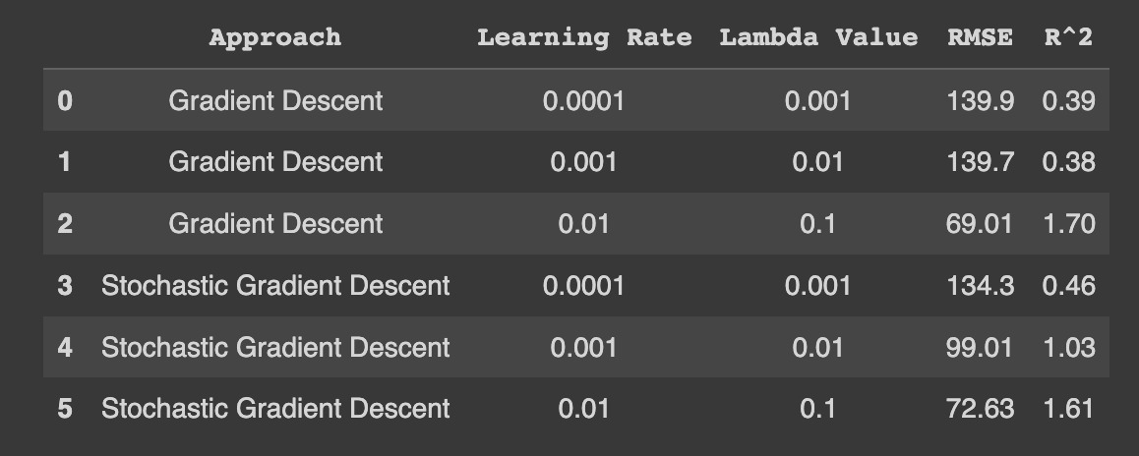
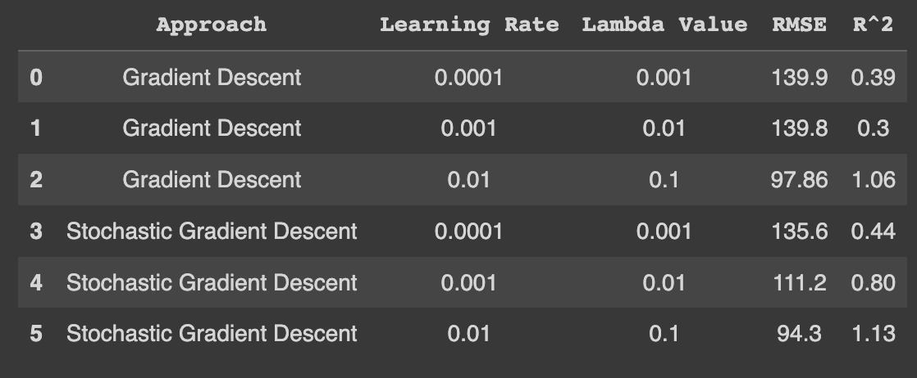
Results
Before PCA
After PCA

Slide 13
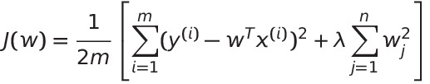

Ridge Regression
Gradient Descent
Predicted and actual values of a dependent variable are compared, with the sum of the squares of the coefficients of the independent variables.
Stochastic Gradient Descent

Slide 14
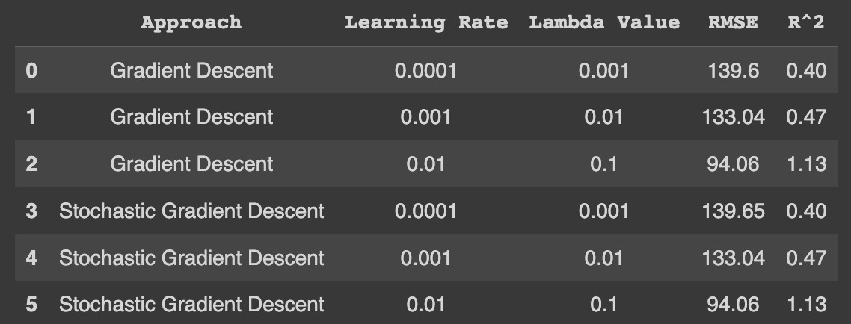
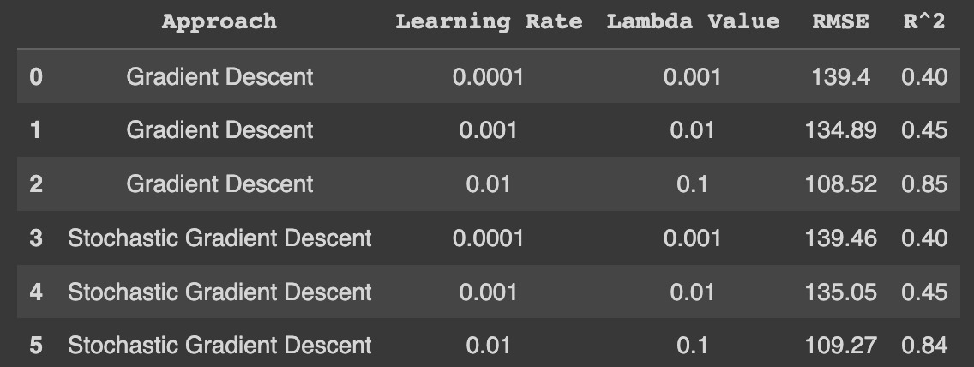
Results
Before PCA
After PCA

Slide 15
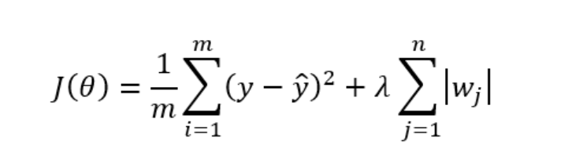
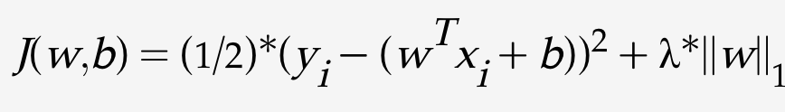
Lasso Regression
Gradient Descent
The objective is to minimize the SSE between the predicted and actual values of a dependent variable
Stochastic Gradient Descent

Slide 16
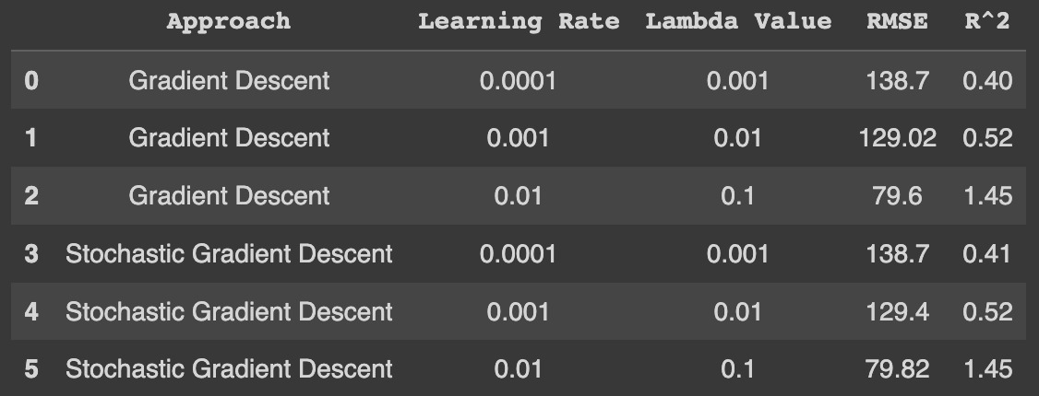
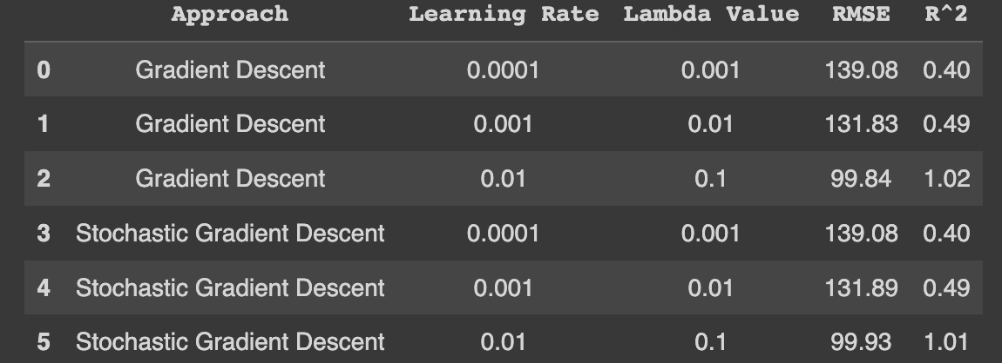
Results
Before PCA
After PCA

Slide 17
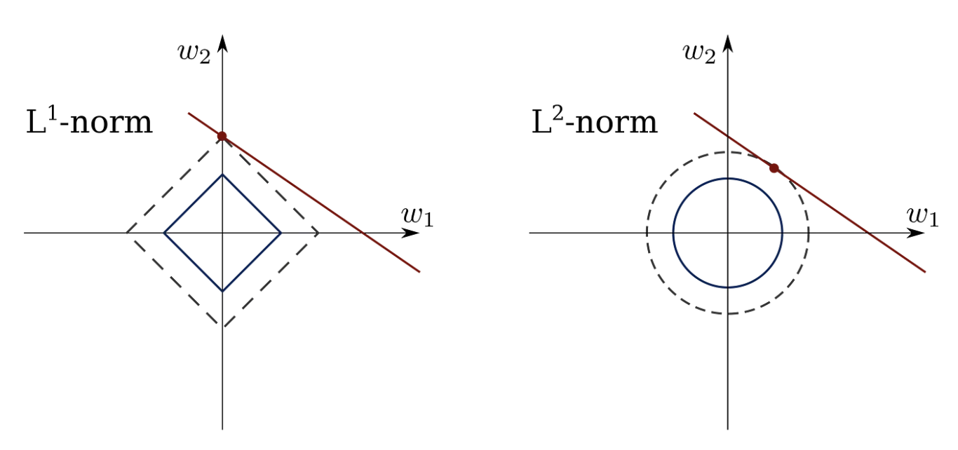
Difference between Lasso and Ridge Regression
Lasso regression (L1-norm) uses the absolute sum of the coefficients as the penalty term
Ridge regression (L2 norm), the sum of the squared coefficients is added to the cost function being minimized
Ridge regression can be effective at reducing the impact of irrelevant features in the model, but it does not perform feature selection
Lasso regression can perform feature selection, eliminating some of the irrelevant features from model
It has effects on shrinking the coefficients towards zero
This penalty shrinks the size of the coefficients towards zero, but it does not set any of them exactly to zero

Slide 18
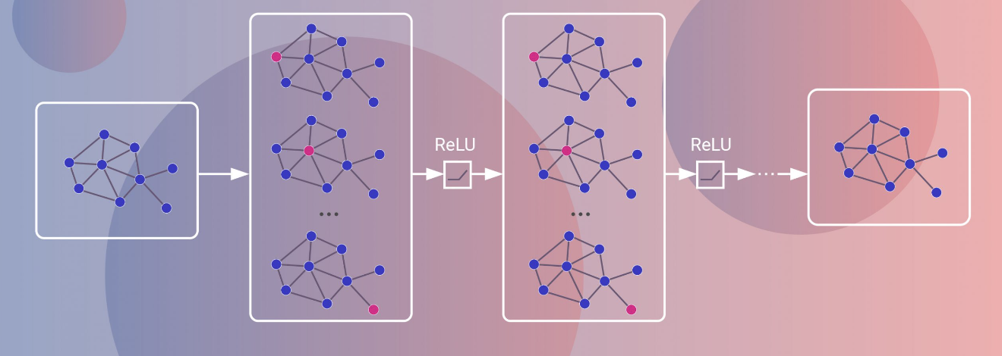
Neural Networks
Neural networks are a type of machine learning model that consists of interconnected nodes called neurons, organized into layers.
These layers can be divided into three main types:
Input layer
Hidden layer(s)
Output layer

Slide 19
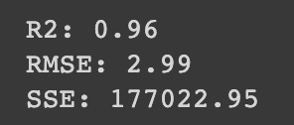
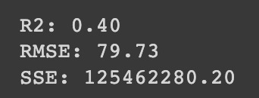
Results
Before PCA
After PCA

Slide 20
Bias – Variance Trade-Off
Bias-variance tradeoff balances fitting training data and generalizing it to new data
High variance leads to overfitting, while high bias causes underfitting
Before PCA
After PCA
Models | Bias | Variance
Linear regression | 11774.64 | 1161.31
Ridge regression | 13859.99 | 683.22
Lasso regression | 12152.19 | 1057.72
Models | Bias | Variance
Linear regression | 11105.64 | 4225.60
Ridge regression | 13788.14 | 1466.68
Lasso regression | 12091.05 | 2684.00

Slide 21
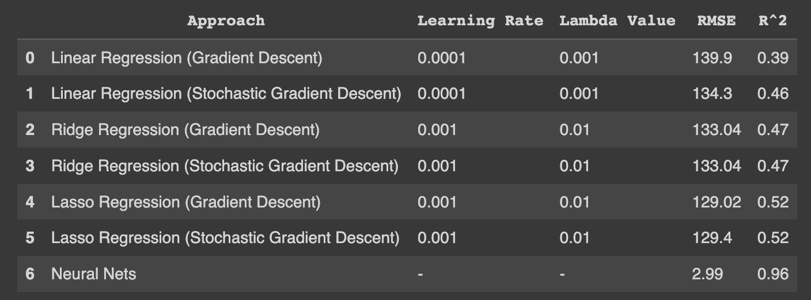
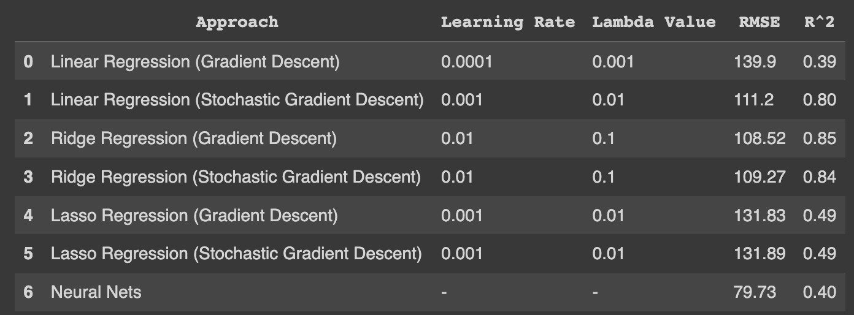
Conclusion
LASSO did the best, followed by Ridge and Linear amongst Regression Models
The Regression models did better after applying PCA than before applying PCA
PCA dropped the number of features down which captured more than 95% variance
Neural Networks had the best performance overall before applying PCA and worst after PCA
LASSO had the same performance for both stochastic and normal gradient descent
Before PCA
After PCA

Slide 22
Future Scope
Approaching the problem statement with Classification algorithms and comparing how well it did with Regression
Exploring this as a Time Series problem to forecast energy usages based on prior trends
Models like ARIMA or Time Series Decomposition Algorithms could be used to predict energy Usage

